Slide 1
DAVID RALPH
Chief Executive
HotSW LEP

Slide 2
Impact
David Ralph
Chief Executive
with thanks to
Adriana Curca, Plymouth City Council
James Gilgrist, Somerset County Council

Slide 3
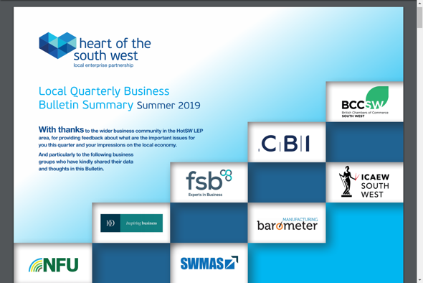
Working with our business community - some new tools
Firstly, a big THANK YOU to our business groups / networks and all the business support providers who work with us
A new quarterly Business Bulletin - a summary of the main business surveys & the “top” issues from the business community
And the top issue: it’s all about the people - recruiting & keeping the right people, with the right skills
If you’re looking for a business group or network, there is now a place on our website to search or add your group:
https://heartofswlep.co.uk/business-groups-networks/

Slide 4
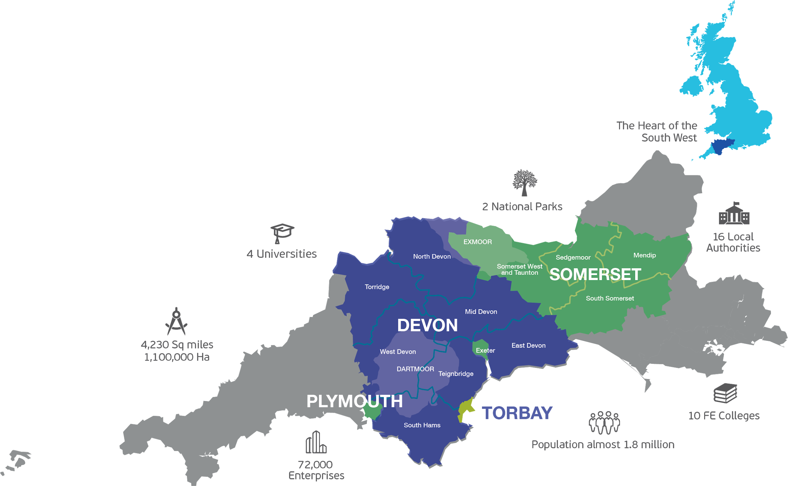

Slide 5
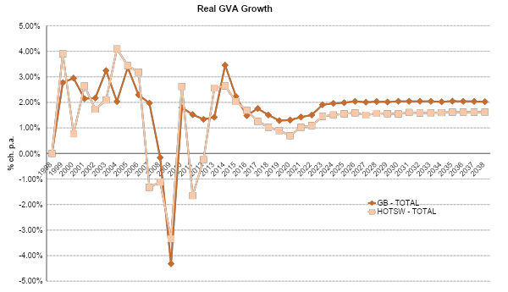
The economy is growing…
The prize: an economy 70% bigger than projection
Transformational growth
‘Do nothing’
FTE employment growth expected to weaken in the near term nationally as well as in HotSW.
In addition, HotSW’s productivity growth is also slowing down.
…but “do nothing” is not transformational!

Slide 6
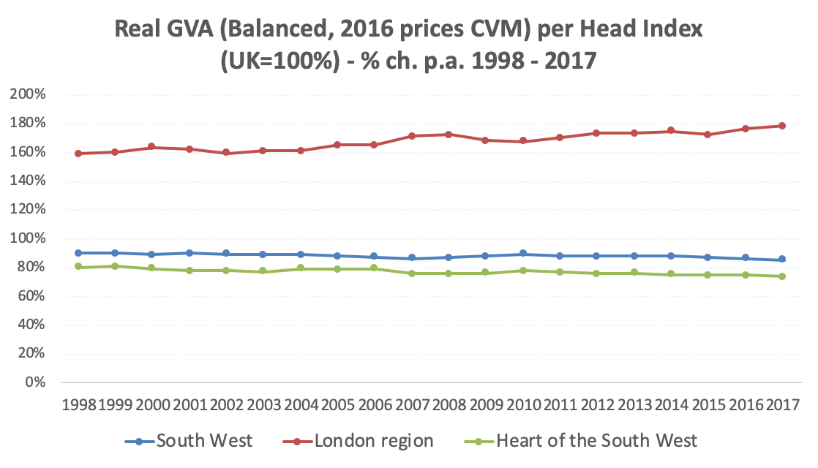

Slide 7
