Slide 1


Exmoor’s
Ambition
for our post-Brexit farming & environment futures

Slide 2
Current situation
Like all other areas of England, Exmoor receives support through the EU Common Agricultural Policy / RDP:
  Basic Payment Scheme payments to farmers: £9.4 M
  Agri-environment agreements: £4.0 M
  Forestry grants: £0.3 M
  Rural Productivity Scheme grants: £0.6 M
This money underpins farming on Exmoor and supports vital natural capital and public benefits
Following Brexit, these scheme will not longer apply
Notes:
Total estimated CAP funding to Exmoor in 2016: £14.4 M. Government also spends an estimated £1.0 M administering these schemes on Exmoor (conservative estimate)

Slide 3
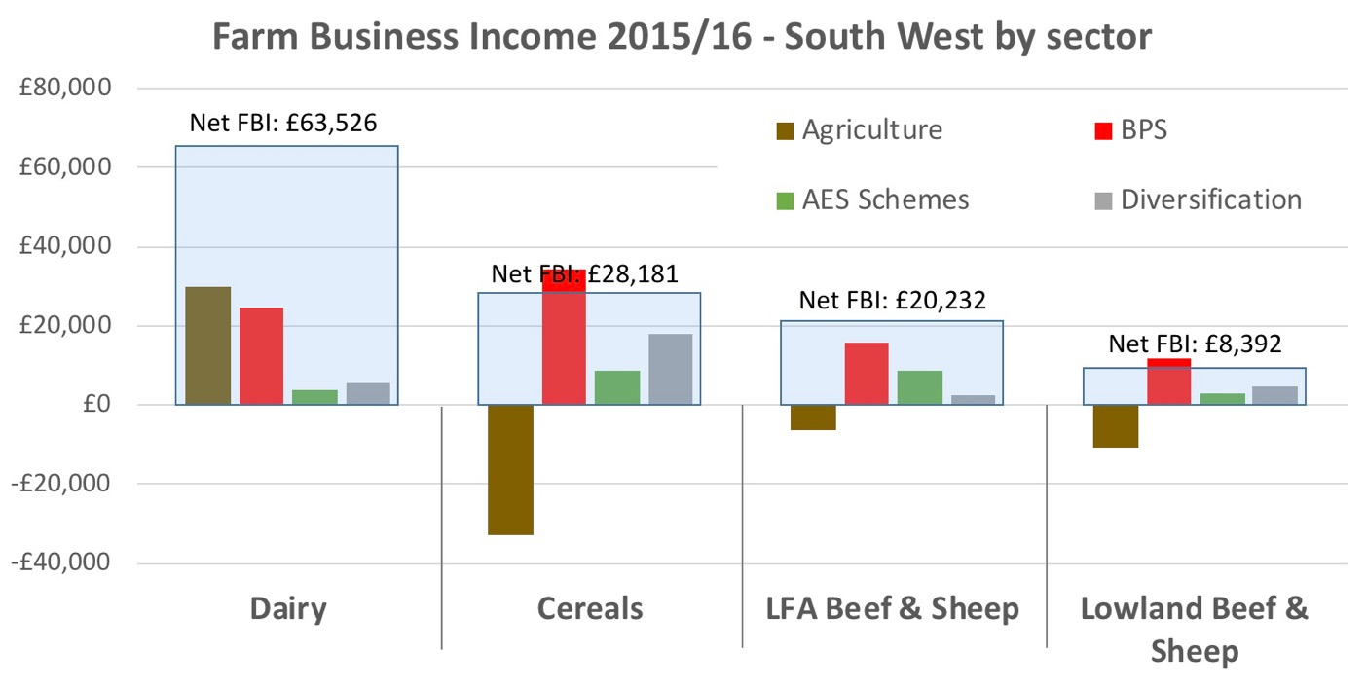
Agricultural support and farm incomes
Source: Farm Business Survey © Rural Business Research, Cambridge
Notes:
FBI without BPS and AES in 2015/16 would have been: £35,413, -£14,719, -£4,102 and -£6,017

Slide 4
Government’s intentions (England)
Overall level of farm support maintained until 2022
Transition period (2019-2024?), moving to public payments for public goods
Top-slicing of BPS from 2020 to fund new approaches
Commitment to ‘new environmental land management system’ consisting of a universal ’broadly accessible’ scheme and a higher tier targeted scheme
Local pilots in 2020-21, for wider roll out in 2022

Slide 5
Exmoor’s Ambition
Our ambition is:
To build on the productive working relationships on Exmoor to develop a locally-delivered mechanism;
To deliver the Government’s 25 Year Environment Plan and the National Park Partnership Plan;
To demonstrate to others the value of approaches piloted on Exmoor.
One of seven proposals submitted to Defra in March by National Parks

Slide 6
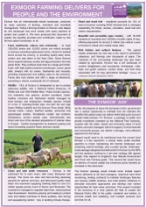

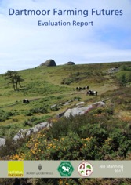
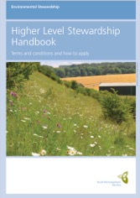
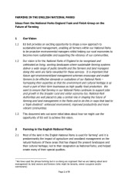

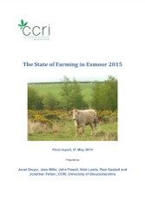
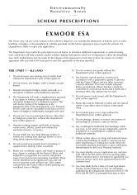
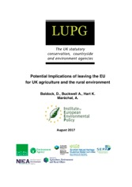

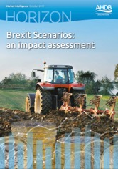
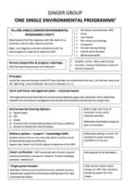
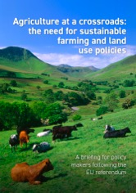
The DNA – How Exmoor got here
‘18
2015
2016
2017
BREXIT REFERENDUM

Slide 7
Goals (from the National Park Partnership Plan)
For People
For Prosperity
For Place
More people enjoy Exmoor, are inspired, get involved, and learn about its special qualities.
Exmoor has a first class rights of way network offering more and better experiences for people who want to explore and enjoy the National Park.
Exmoor’s farmers supported to provide healthy food and good quality timber, ensuring that Exmoor’s landscapes are cared for.
The local economy is more sustainable with increased innovation, entrepreneurship and improved prospects.
Exmoor’s landscapes are celebrated, conserved and enhanced.
The historic environment is better understood & protected.
Exmoor is richer in wildlife. Habitats are in good condition, expanded, connected, and support more species.

Slide 8
Design principles and points of difference
Justified by the full range of public benefits – rewards and incentivizes
Addressing big challenges – transformational
Led by results – not driven by prescriptions
Uses the concept of Natural Capital to recognise what’s important – including cultural and social capital
Steered by local people, including participants

Slide 9
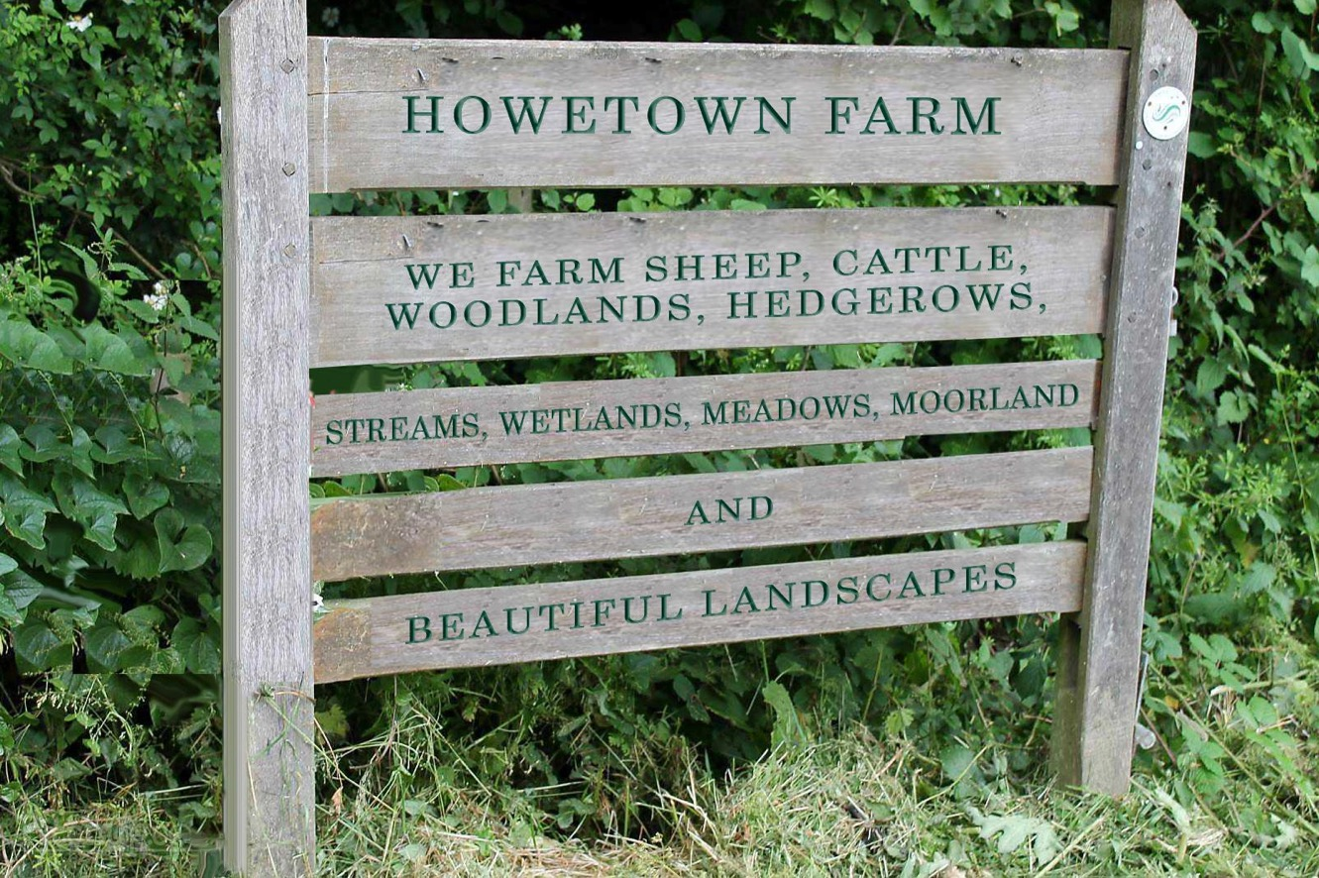
Branding of Exmoor (not just funding)
Changing perceptions – Telling the whole Exmoor story
Earning a premium price for a premium place
Making Exmoor even more mouth watering

Slide 10
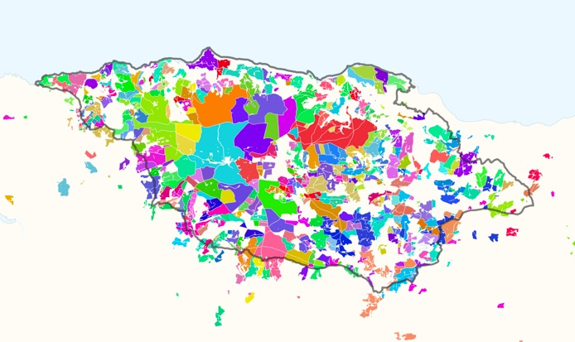
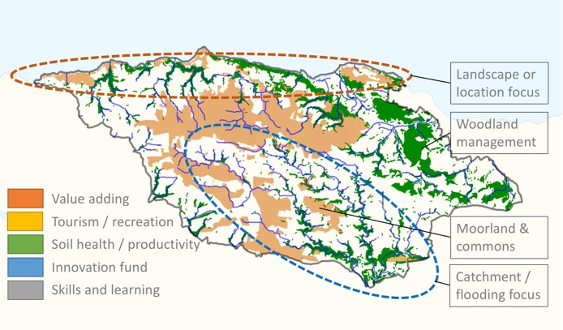
Two types of incentive
A. Good Farming Measures
B. Enhanced Benefits Measures
Colours represent separate holdings in current ES scheme
Simple agreements with individual businesses
Landscape scale / supply chain programmes
Annual land management payments (area & length) differentiated by benefits provided
Multi-annual measures focussed on outcomes
Capital grants for conservation work
Transformational change, addressing area-wide, priorities (environmental, social or econ.)
Underpinned by agreed register of natural capital
Range of incentives (e.g. area payments, auctions, challenge funds, grants)
Supported by knowledge-sharing events
Monitoring and learning what works fed back to improve future delivery

Slide 11
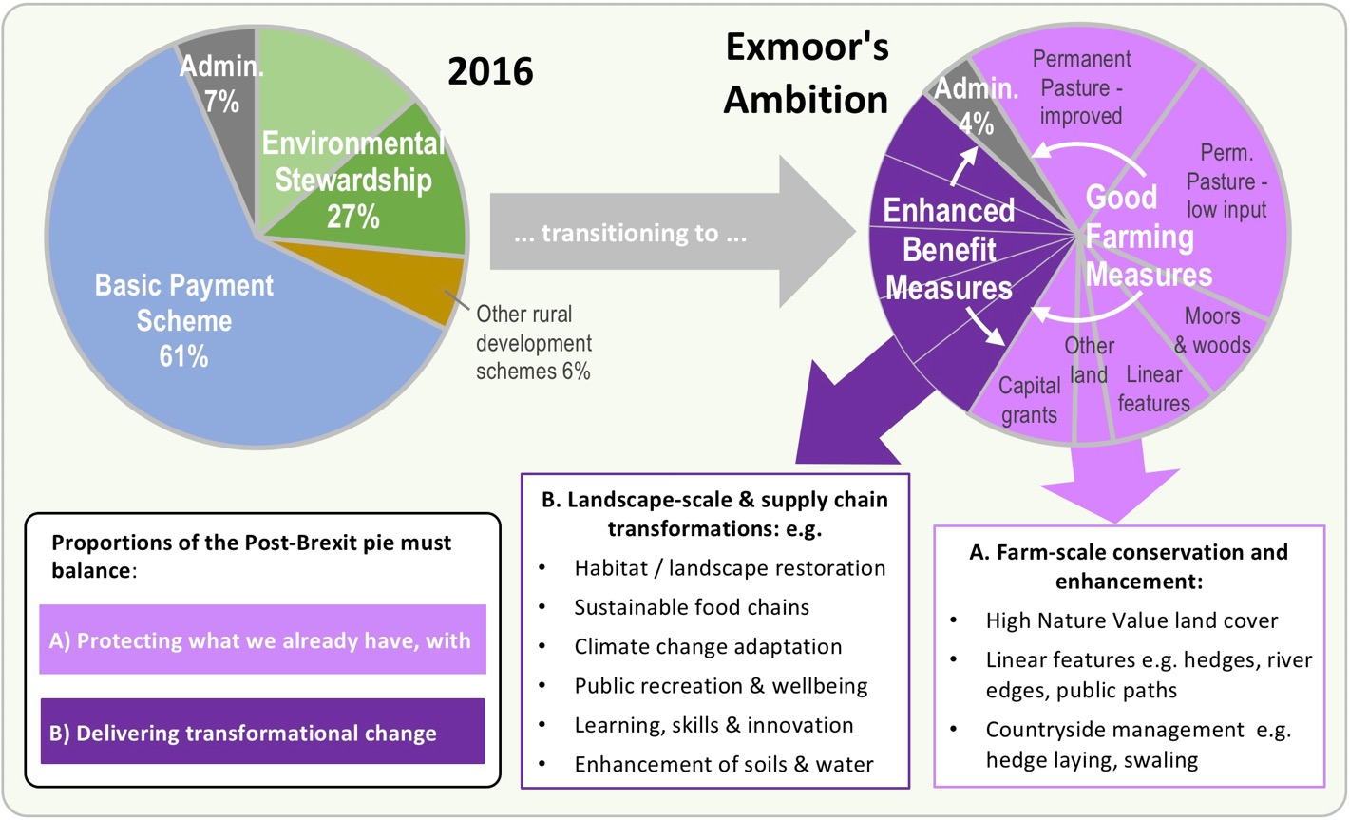
Exmoor’s Ambition – Before and After

Slide 12
Timeline – What next?
Present to SoS; Liaise with Defra
Bid for development funding
UK LEAVES THE EU
Policy transition period
Farm & Environment budgets maintained until ?2024
Move from current Pillar 1 & 2 structures to ?
‘21
2018
2019
2020
Our intended plan:
Development Phase
Full Pilot Phase
Recruit pilot farmers
Develop measures
Test payment levels
Build governance & delivery mechanisms
Contract with delivery bodies / employ staff
Prepare register of natural & cultural capital
Roll out Good Farming and Enhanced Benefits measures
Enter agreements
Monitor results and feedback
Evaluate
Evaluate

Slide 13

www.rural-focus.co.uk

